Slide 1






Flook

Slide 2



Flook

Slide 3
ToDay Recipe View
Situation Recipe View

Slide 4
ToDay Recipe View
Mood Recipe View

Slide 5





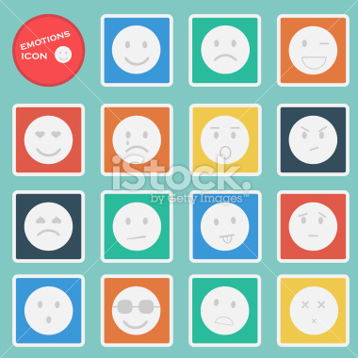





Slide 6



